Slide 1
Mothers
Mothers are……….
Add 3 adjectives

Slide 2
Fathers
Fathers are ……..
Add 3 adjectives

Slide 3
Supporting Young Fathers in Promoting Their Child’s Development
Encouraging males to be involved for the benefit of themselves, their family and the whole community

Slide 4
The WHY
Fatherless Homes….
90% of all homeless and runaway children
63% of youth suicides
85% of children with behavioral disorders
71% of all high school dropouts
5 times more likely to commit suicide
32 x more likely to run away

Slide 5
Children from Fatherless homes are…..
20 x more likely to have behavioral disorders
14 x more likely to commit rape
9 x more likely to drop out of school
10 x more likely to abuse drugs
9 x more likely to end up in state institution
20 x more likely to go to prison
4x more likely to suffer infant mortality

Slide 6
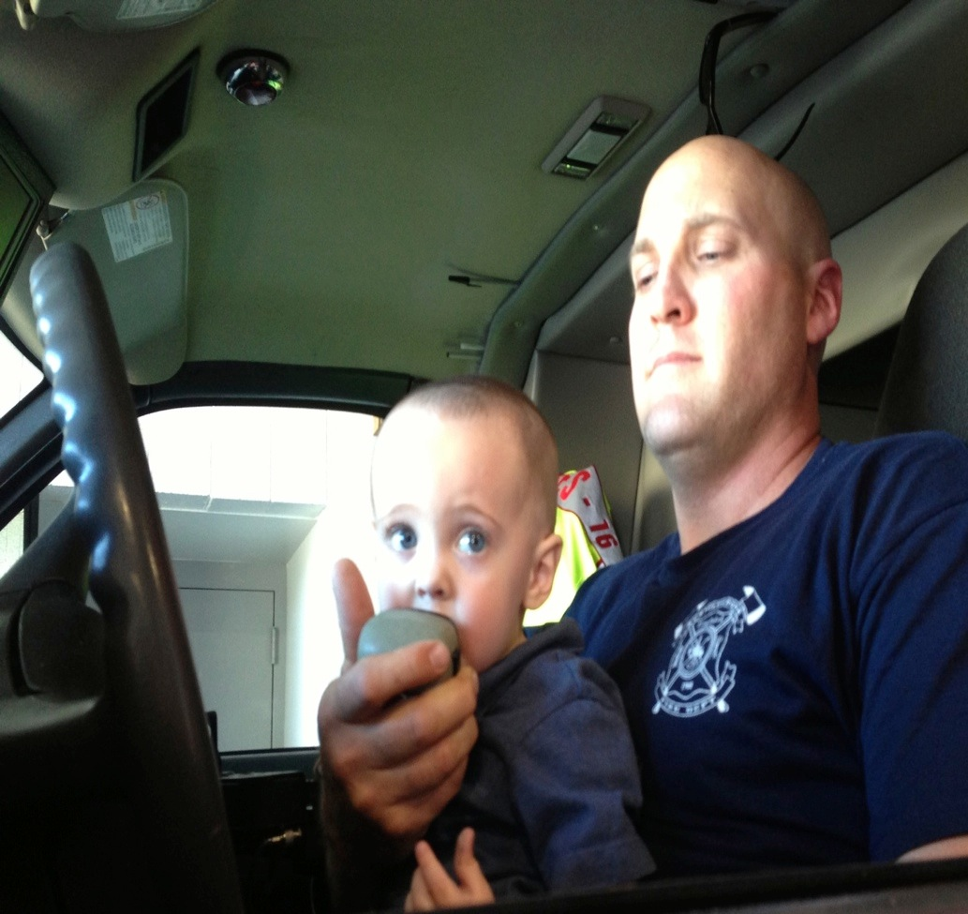
Moms and Dads are Different
Dads spend more time in play
Dads will encourage risk taking
Dads offers less immediate support in face of frustration which promotes better anger management
Moms spend more time in physical care
Moms will stress emotional security and safety
Moms likely to intervene more quickly in face of child's frustration

Slide 7
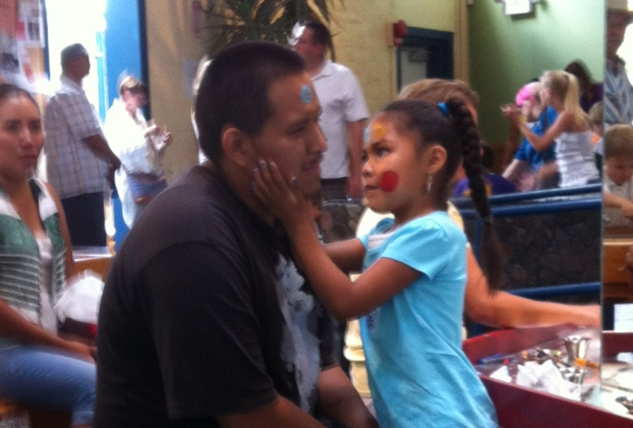
More Moms and Dads parenting styles
Moms teach with focus on process of learning
Moms promote emotional awareness
Moms promote independence inside the home
Dads teach through example, learning from experience
Dads promote exploratory freedom
Dads promote independence outside the home

Slide 8
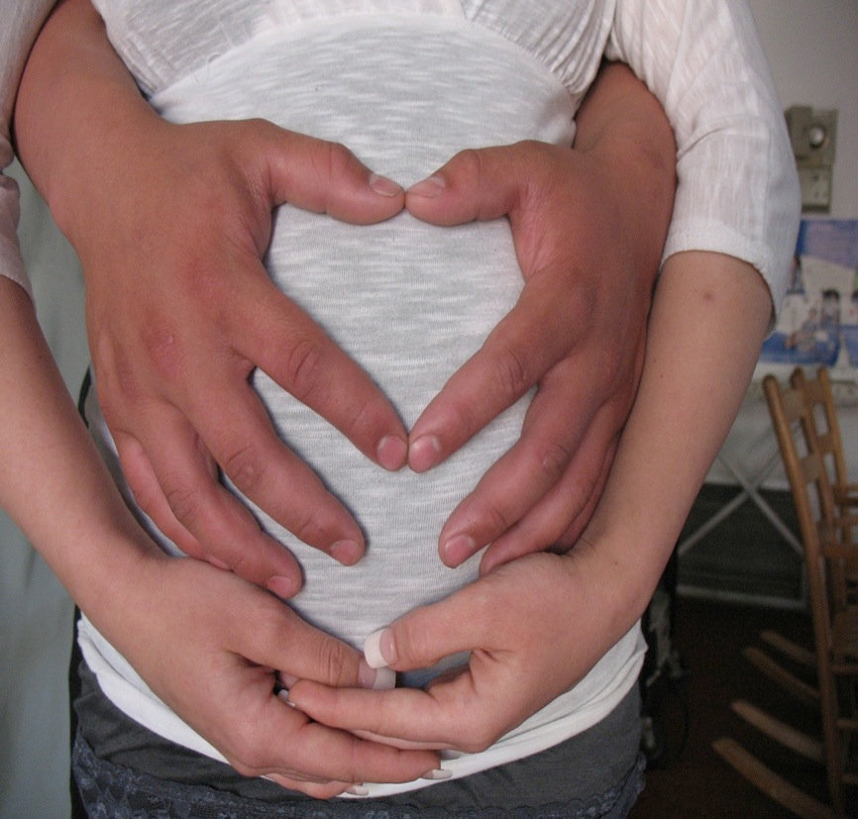
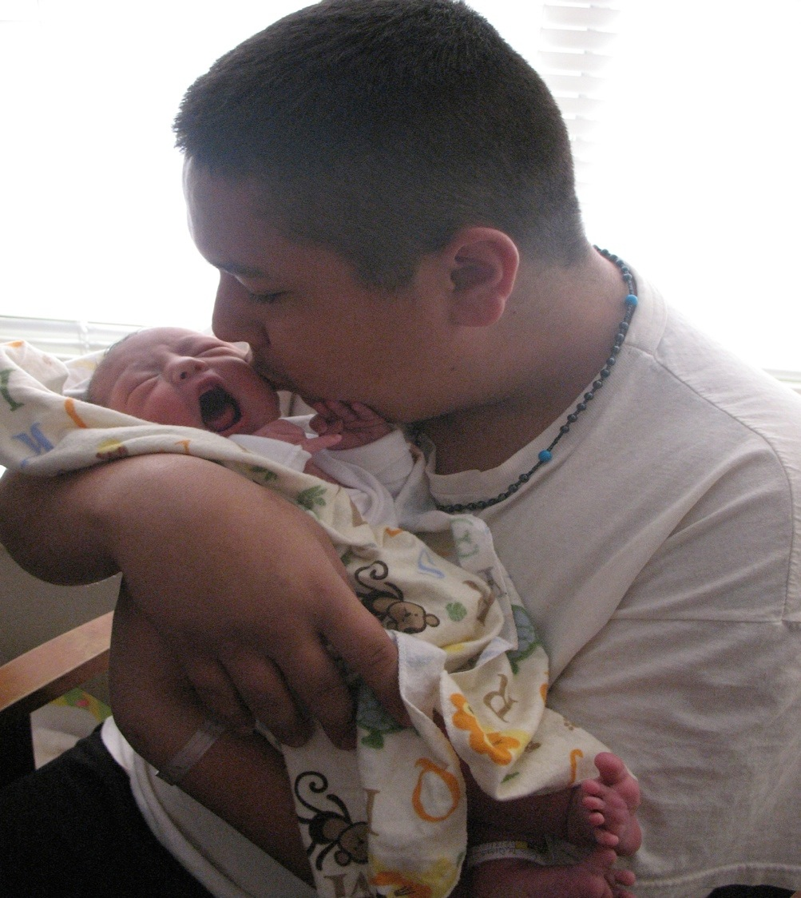
Stages - examples
Birth to 6 months; Early eye control, motor control (balancing head, rolling, pulling, brief sitting…), grasping.
Dad will - encourage pulling, exercise legs and arms, be excited by sitting, test the limits.
Coos, Learns through senses (eyes, ears…), imitates movements.
Dad will - talk in different ways, make funny faces, bounce and jostle

Slide 9
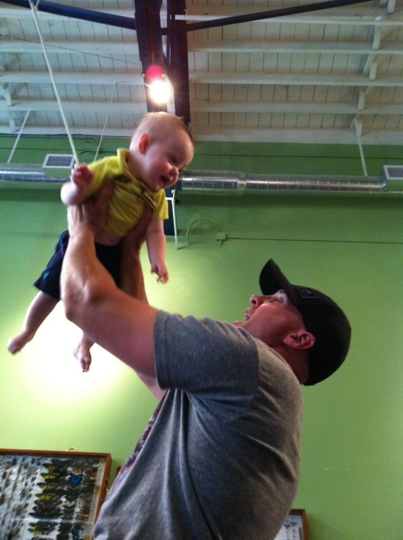
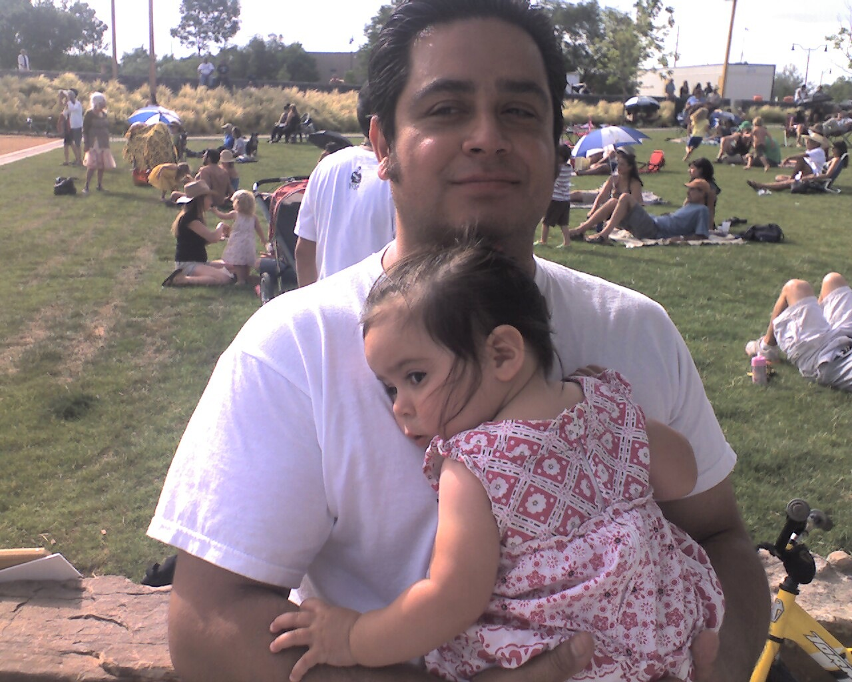
Stages - examples
6 months to 1 year; Begin to crawl/walk, let go with hands, responds positively to novel items/activities,
Dad will - Encourage with more risk, offer unique games (balance, surprise)
recognizing word meaning, will babble
Dad will - talk more ‘normal’ and use more words

Slide 10
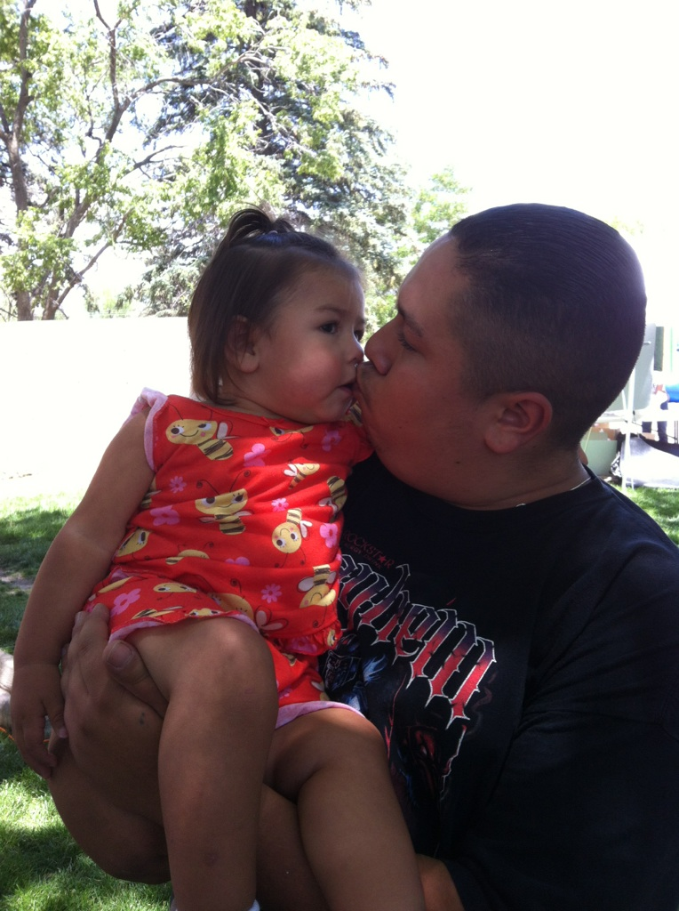
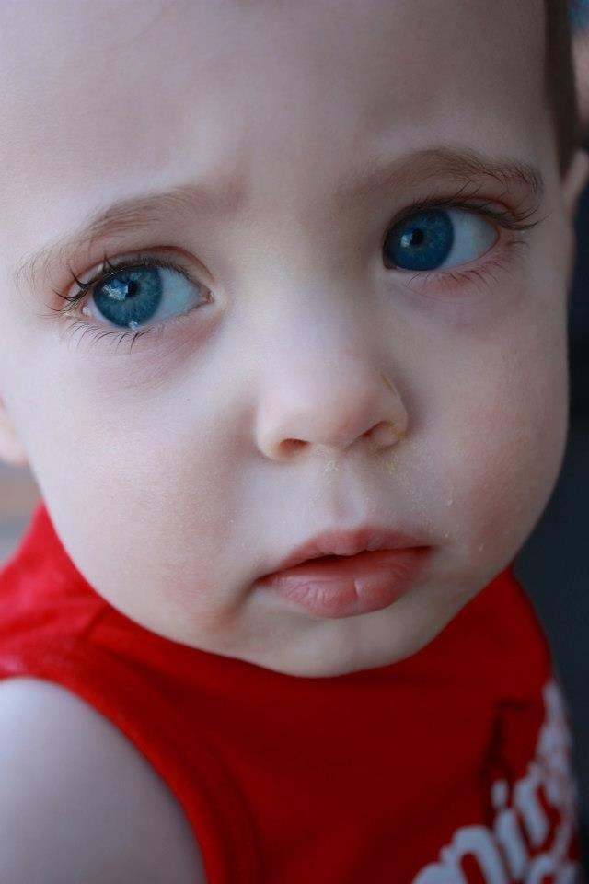
Stages - examples
1 to 2 years; Walking, pushing/pulling, Stacking, exploring (texture, space, language)
Dad will - Encourage child to do for themselves, provide a variety of objects for play/exploration.
Pushing boundaries, demanding
Dad will - explain “no”, allow more risk

Slide 11
Understanding Men
Men have often been trained and shown how not to express emotion.
The subtle emotions are not identified or named
The one that is allowed and shown is ANGER
Men can be overwhelmed trying to be successful in work, relationships, and as parents
Little opportunity for men to express their pressures (or even aware of it)
Men are action and solution oriented

Slide 12
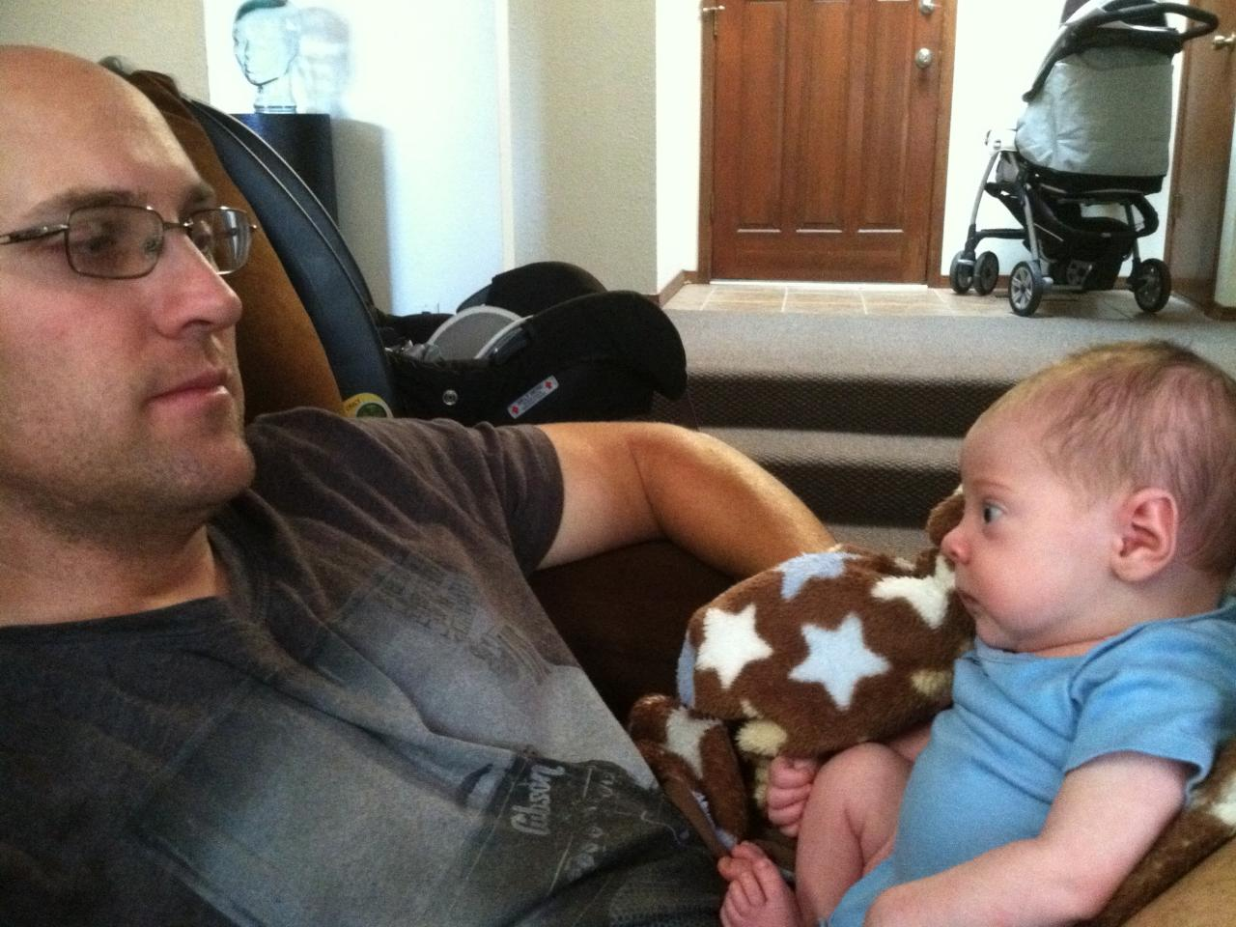
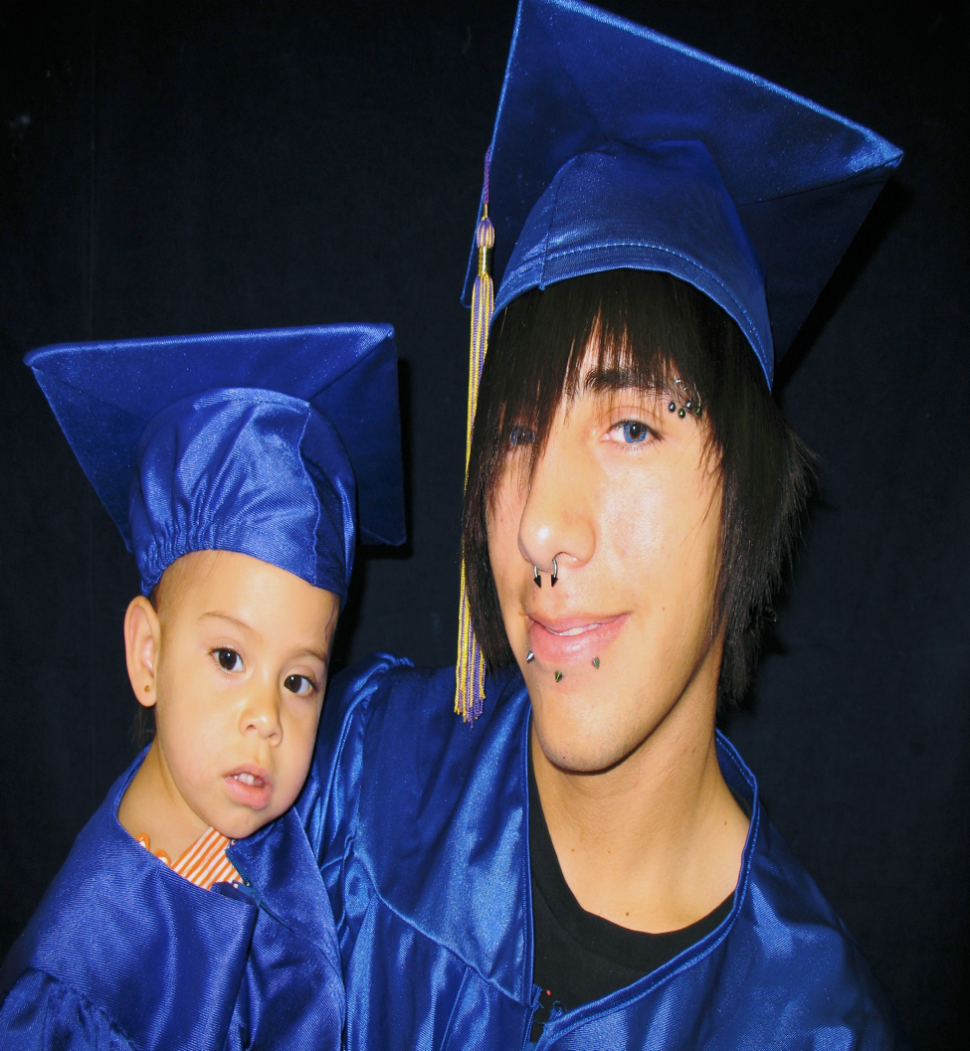
What To Do To Encourage Male Involvement
Acknowledgment
Recognize and structure his contributions in “Action” or as problems to be solved
Provide “Safety” (encouragement)
Appreciation

Slide 13
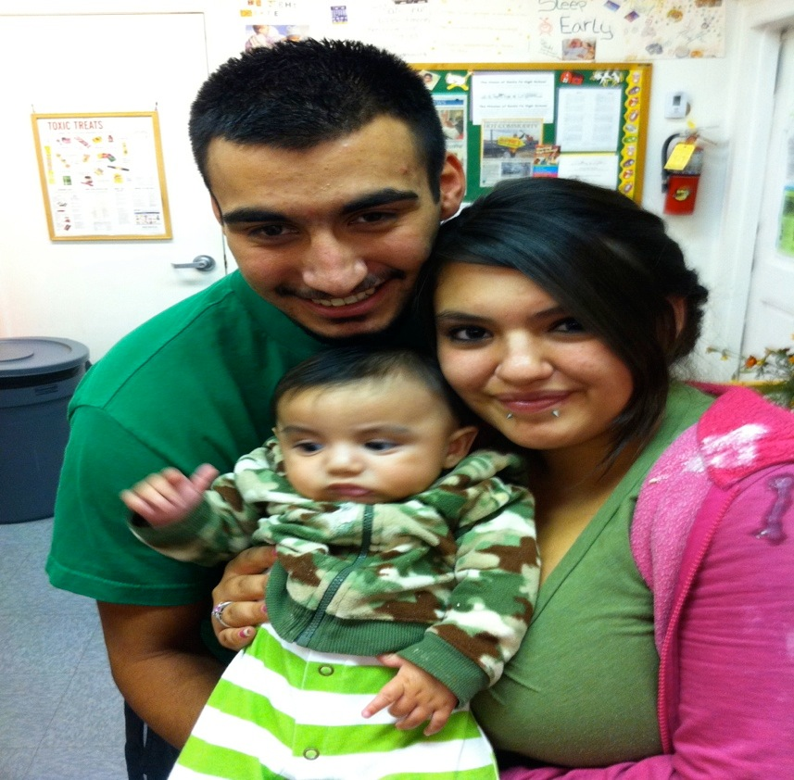
Acknowledging Men
(a primer)
I messages
I appreciate when………….(describe behavior)
Because I feel ……………..(feeling word)
And that makes me ………..(effect on you)

Slide 14
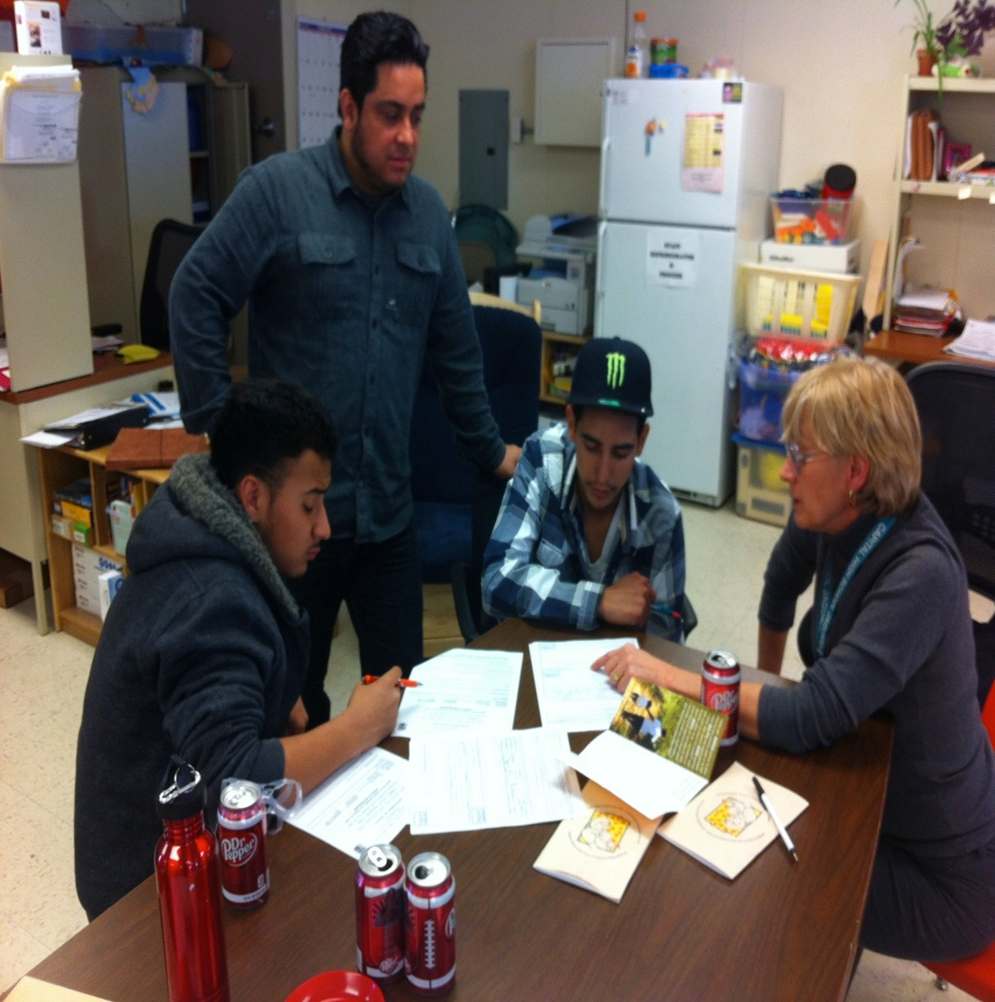
What To Do To Guide Young Fathers Toward Improved Interactions
Action Oriented Steps…
Recognize/Structure his role/contribution (because men like to solve problems)
Give him an action or job to do
Ask for his ideas and suggested solutions
Encourage their solutions
expand, specific references to father behaviors…

Slide 15
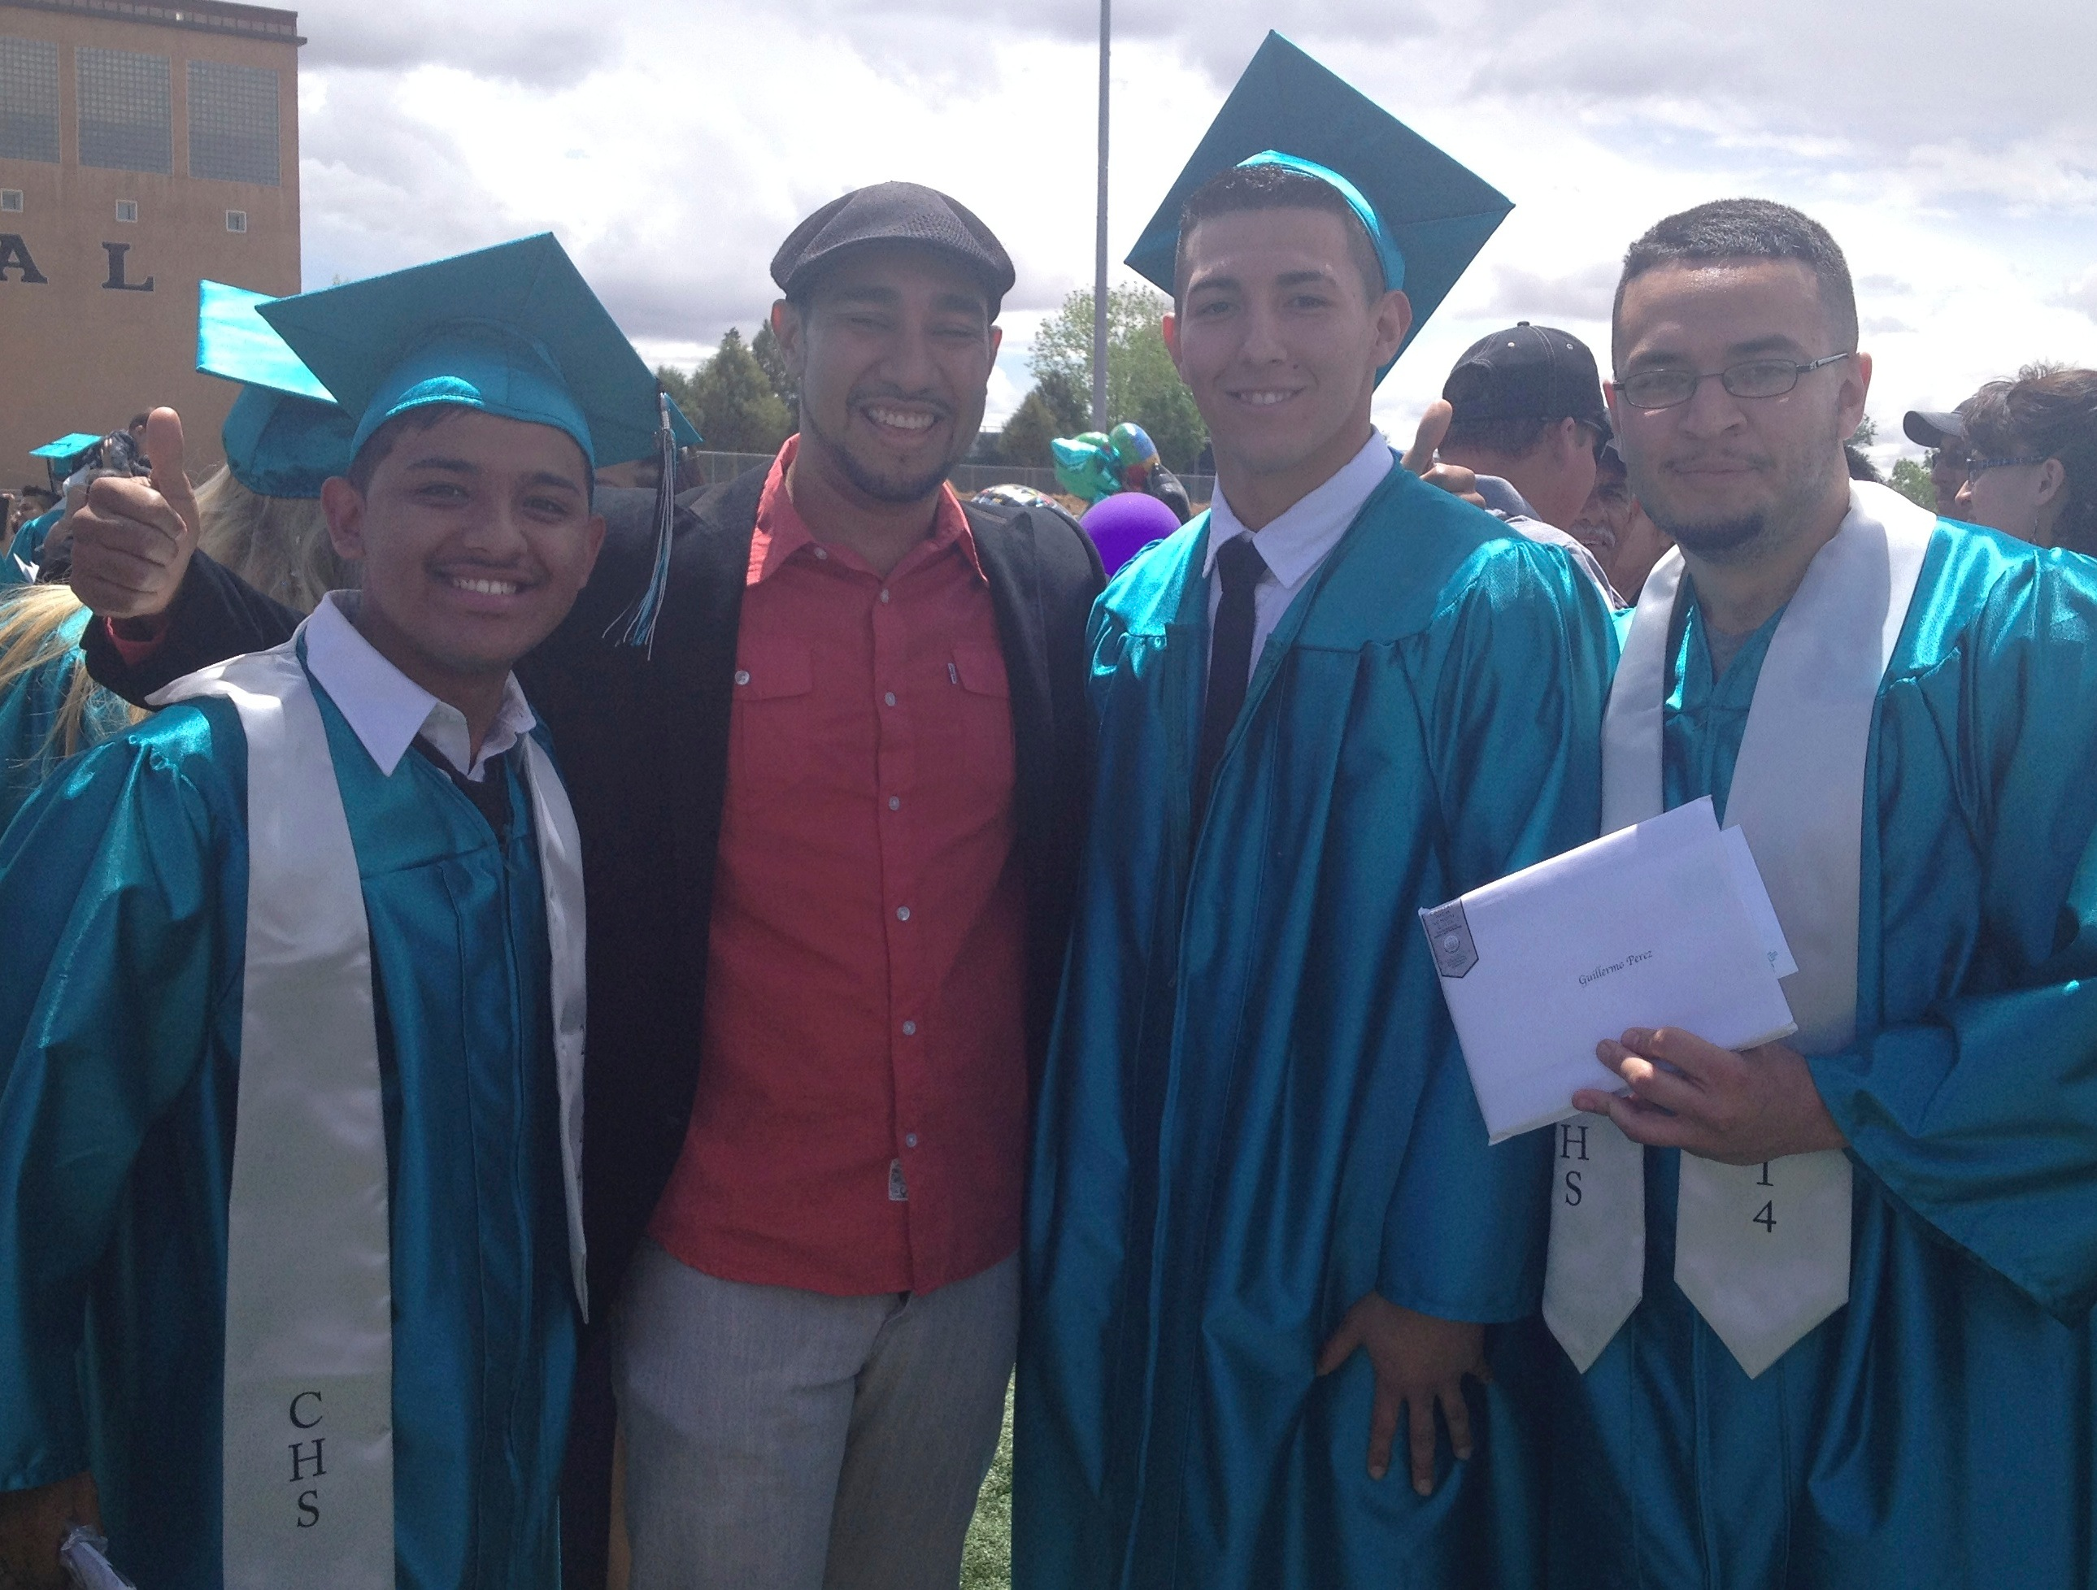
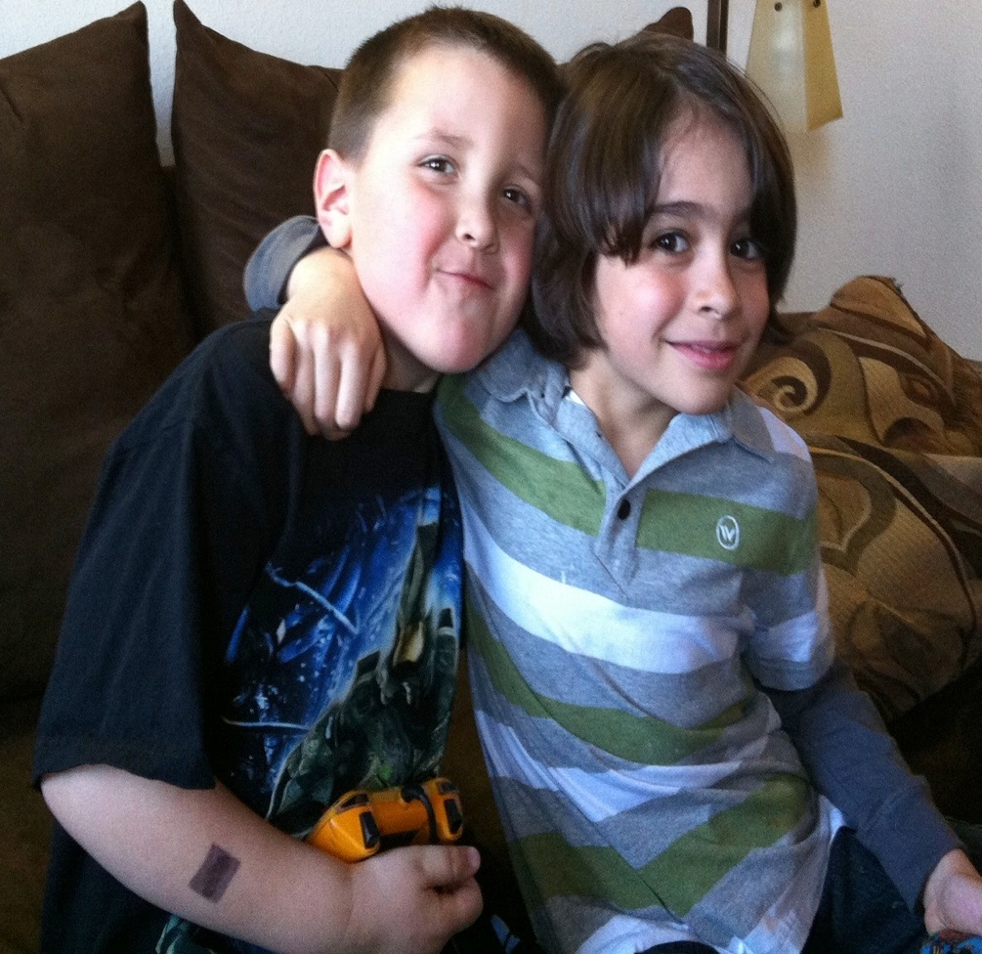
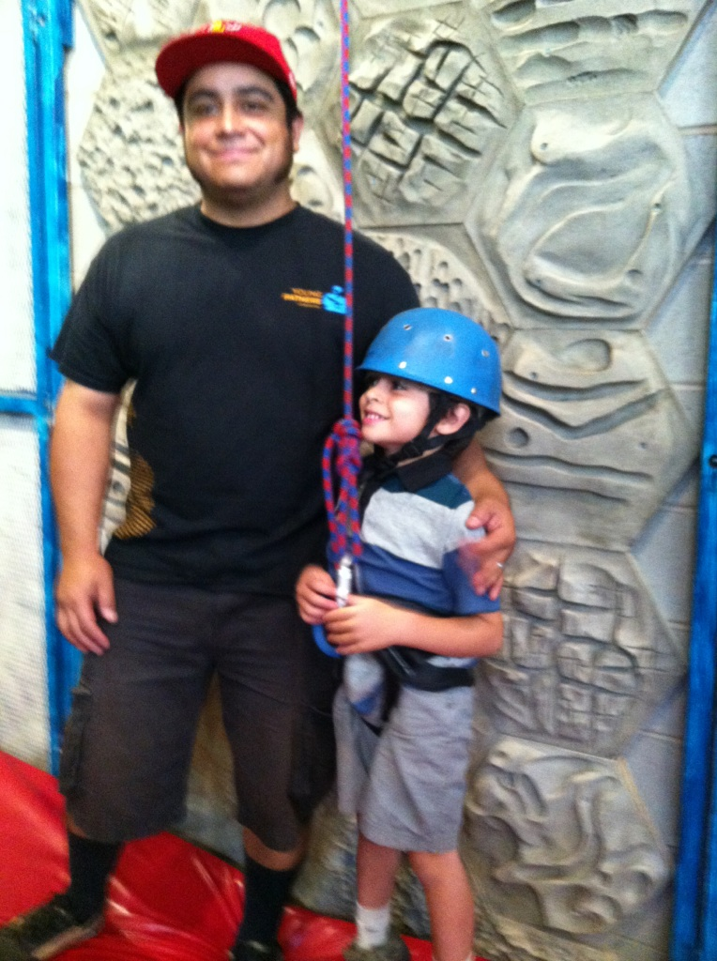
Provide Safety
Give him a confidential place to express his concerns and frustrations
Offer fathers group for peer support and a sense of community
Carefully guard against criticisms that undermines male/father tendencies

Slide 16
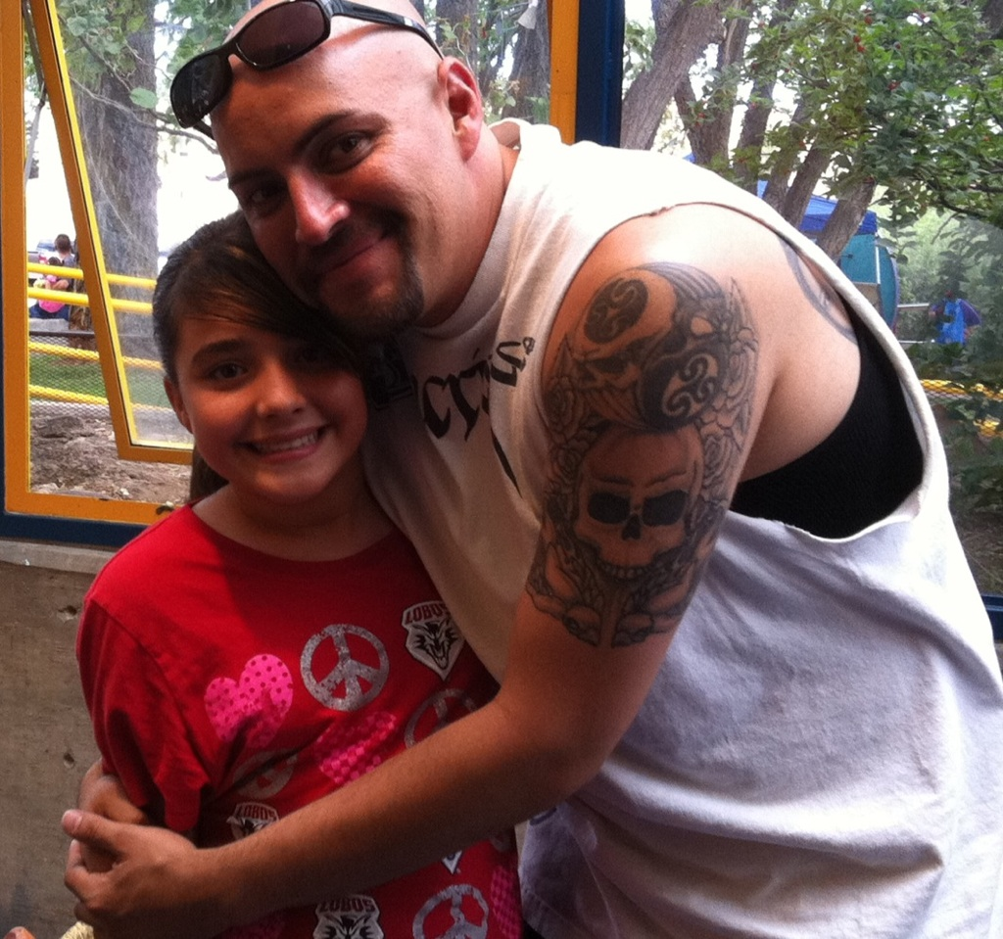
What can work
Expect involvement, program staff act in a manner that communicates the expectation.
Plan for it
Plan visits so it can happen
Don’t accept anything less

Slide 17
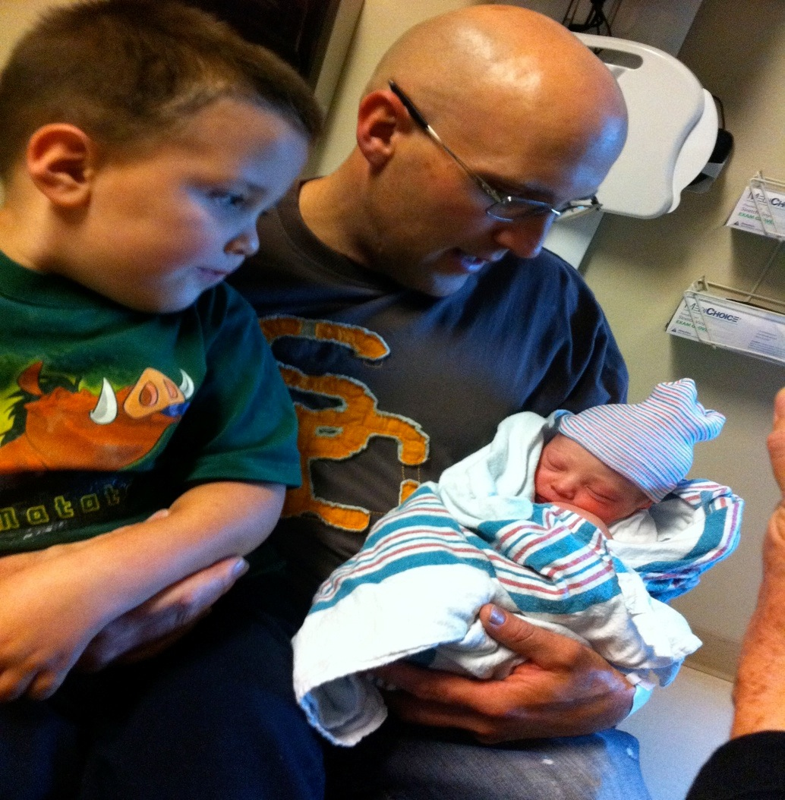
What can work
View males as essential, not a risk factor
Invite men in, that’s maybe all they are waiting for
Understand fathers motivation:provider and protector

Slide 18
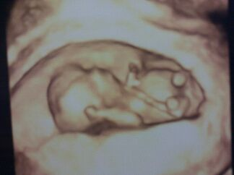
Touchstones
Pregnancy
Birth
Illness
Child - starting school/loss of child care
Developmental Milestones (weening, walking, talking, adolescence…)
Father - job loss/going to school

Slide 19
Birth and Pregnancy
Birth
Testosterone drops 33% for 1 month after birth
Estrogen increases 1 month prior and 3 months post birth
Prolactin increases 20% for 3 weeks post birth

Slide 20
Barry McIntosh, Director
(505) 699-7431
kbmac@cybermesa.com
Johnny Wilson
(505) 377-8950
tokaprod@gmail.com

